Slide 1
Tim Cook
Name
Institution of Affiliation
Professor
Date
Notes:
Introduce yourself and call for attention from the audience

Slide 2
Tim Cook
Tim Cook is the chief executive officer of Apple Company.
The company is the most valuable one in the world.
He was appointed the CEO of the company after the death of Steve Jobs, the founder of the company (Perry, 2016).
His appointment was in year 2011 before that he was the company’s chief operating officer.
Notes:
Start by mentioning who is Tim Cook and why you choose him
Apple Inc Company is an international company and has been on operation for a long time
Cook took over from Steve Jobs who died from pancreatic Cancer that was diagnosed at stage 4
Cook was a close friend and confidant of Steve Jobs

Slide 3
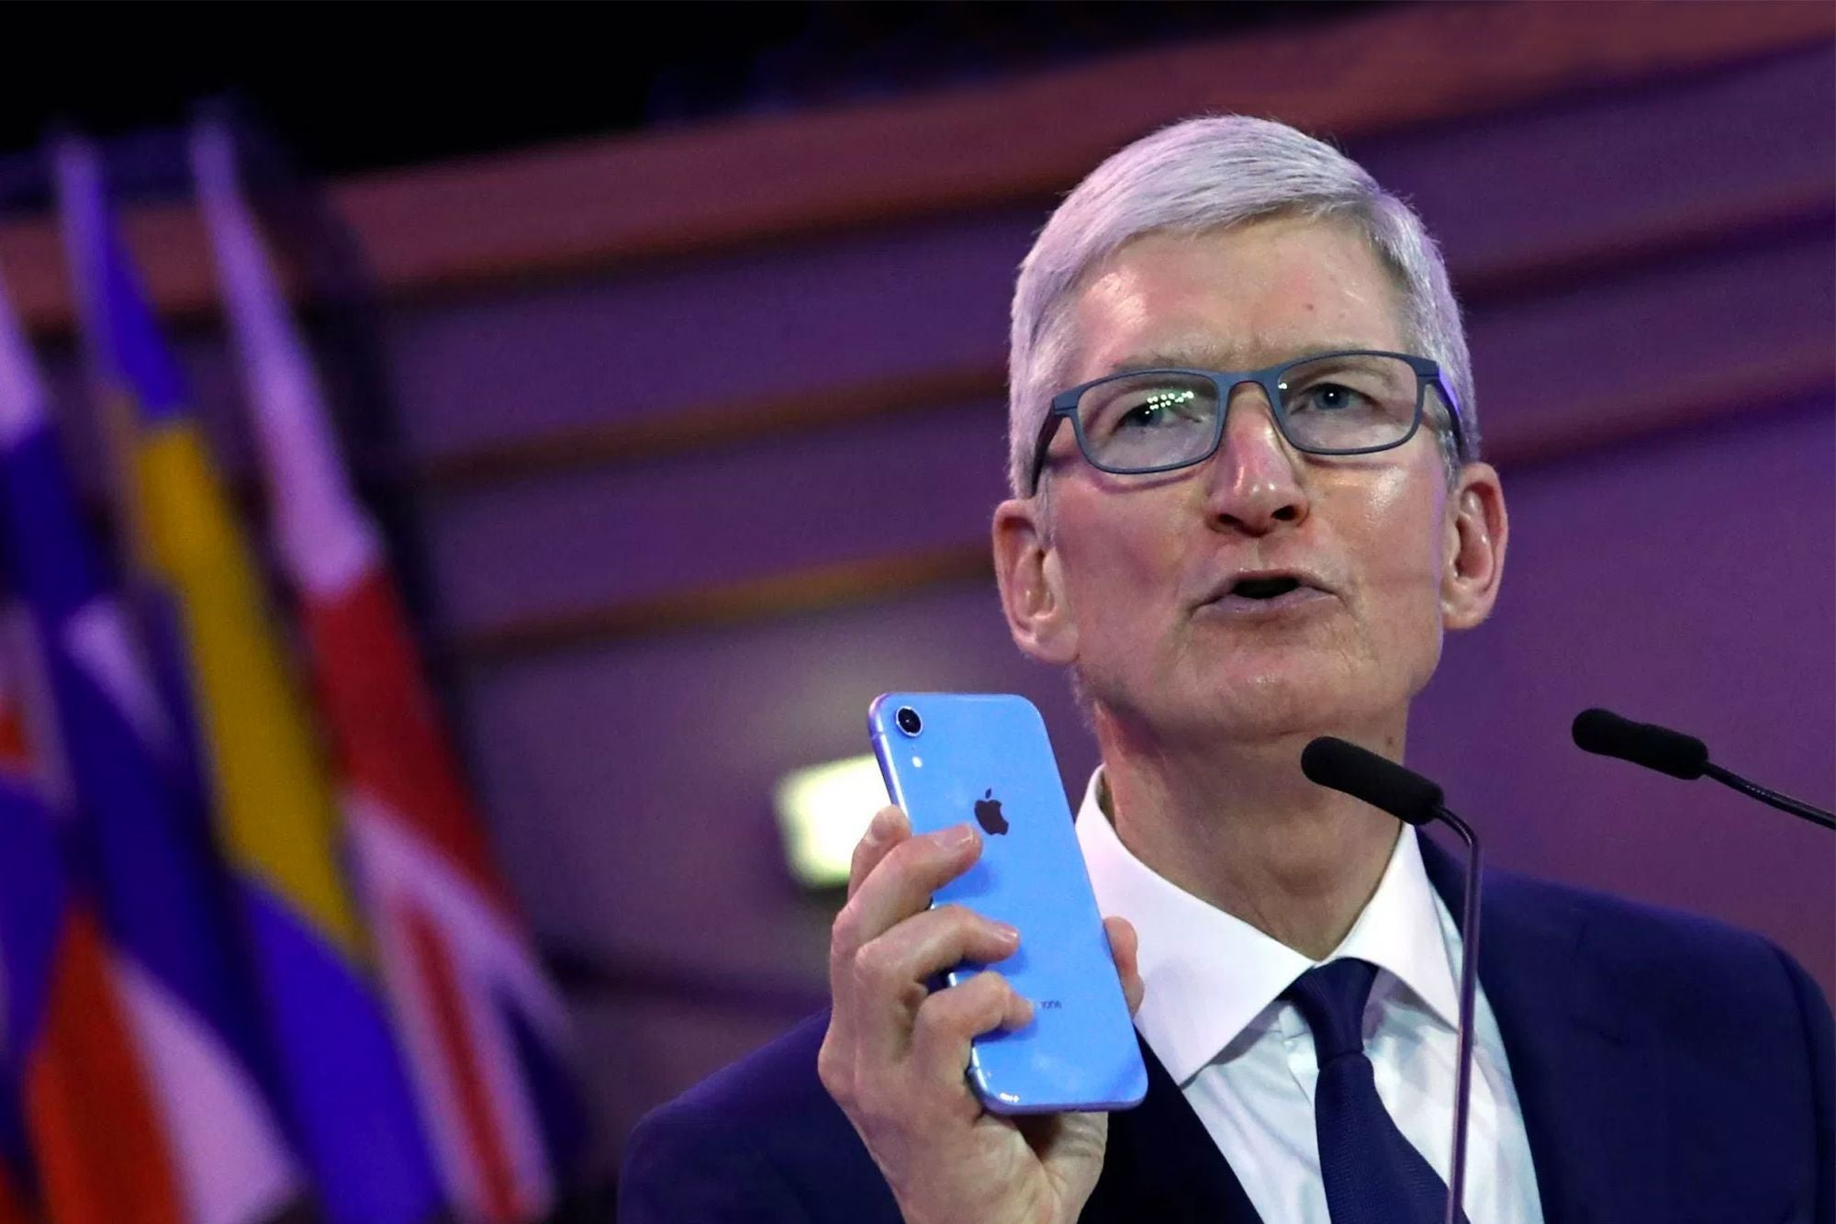
Notes:
This is Tim Cook who is now turning 60 years

Slide 4
Early Life and Education
Tim Cook was born in 1960 in Alabama, US.
He graduated from Robertsdale High School in 1978.
Attended Auburn University where he graduated with a bachelor degree in industrial engineering in 1982 (Heracleous & Papachroni, 2016).
He later studied his MBA in Duke University's Fuqua School of Business and graduated in 1988.
Notes:
Just narrate that he was born in Alabama, US
State his education life as per the slides
Attended Auburn University where he graduated with a bachelor degree in industrial engineering in 1982 (Heracleous & Papachroni, 2016).
studied his MBA in Duke University's Fuqua School of Business and graduated in 1988.

Slide 5
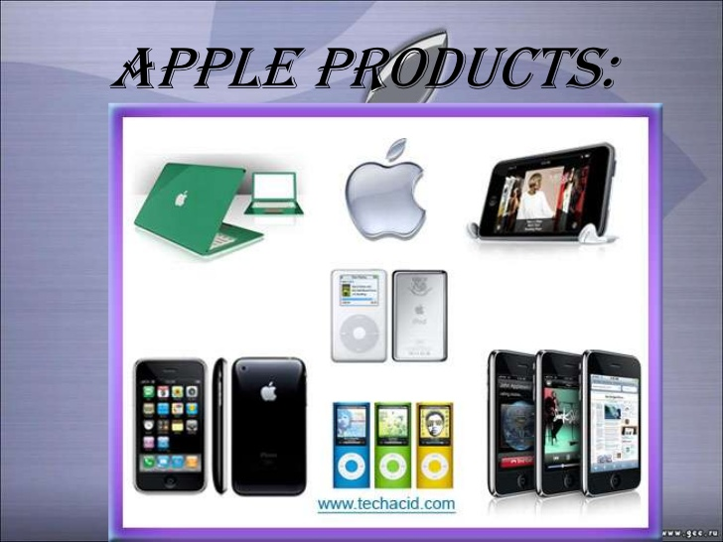
The company Tim Works
Appl Inc Company is a company technology company that was founded by Steve Jobs, Steve Wozniak, and Ronald Wayne in April 1976 (Ceil, 2018).
The company products include consumer electronics, computer software, and online services.
Notes:
Apple Inc. is an American multinational technology company headquartered in Cupertino, California, that designs, develops, and sells consumer electronics, computer software, and online services. It is considered one of the Big Tech technology companies, alongside Amazon, Google, Microsoft and Facebook.
Stock price: AAPL (NASDAQ) US$425.04 +40.28 (+10.47%)
Founded: 1 April 1976, Cupertino, California, United States
CEO: Tim Cook (24 Aug 2011–)
Headquarters: Cupertino, California, United States
Founders: Steve Jobs, Steve Wozniak, Ronald Wayne
Subsidiaries: Apple Store, Beats Electronics, NextVR, Inc., MORE
Products: Apple Watch, iPhone, Apple TV, Apple iPad Family,

Slide 6
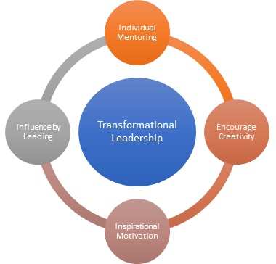
Transformational Leadership Theory
A leadership theory where the leader’s style is inspiring and motivating members to creating positive changes within the organization.
Notes:
Transformational leadership is an approach in which a leader inspires and motivates team members to create positive changes within an organization.
This leadership style can increase group morale, lead to rapid innovation, improve conflict resolution, decrease turnover and foster a sense of ownership amongst a team.

Slide 7
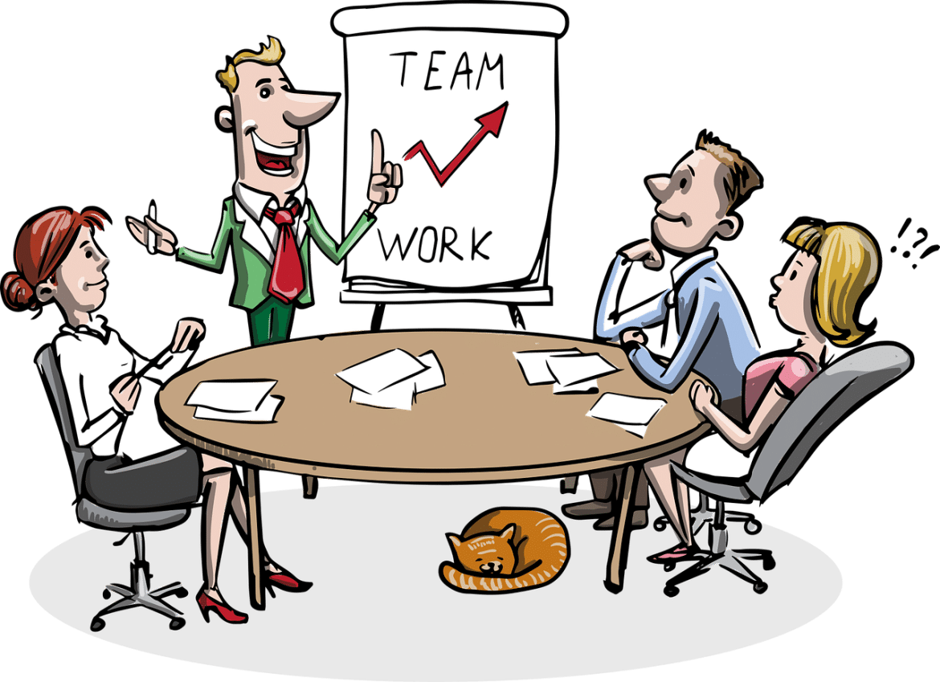
Transformational Leadership Theory…
This leadership style increase group morale, lead to rapid innovation, improve conflict resolution.
Notes:
Transformational leadership is a process where leaders and followers raise each other up to higher levels of motivation and morality.
Through transformational leadership, both a leader and her team develop their skills and qualities as individuals.

Slide 8
Characteristics of a Transformative Leader
Provides encouragement
Sets clear goals
Provides recognition and support
Models fairness and integrity
Provokes positive emotions in others
Inspires people to achieve their goals
Notes:
Transformational leadership is a process where leaders and followers raise each other up to higher levels of motivation and morality. A good transformational leader does the following:
Provides encouragement
Sets clear goals
Provides recognition and support
Models fairness and integrity
Provokes positive emotions in others
Inspires people to achieve their goals

Slide 9

Steps Involved
In order to benefit from this model, a leader must understand the steps involved in the process as well as how transformational leadership can benefit the entire team.
These steps are:
Creating an inspiring vision of the future.
Motivating people to buy into and deliver the vision.
Managing delivery of the vision.
Building ever-stronger, trust-based relationships with your people (Kahney, 2019).
Notes:
Some of the most common character traits among successful transformational leaders include mutual respect, organizational skills, creativity, responsibility and integrity. It is vital to intellectually challenge those you lead, consider each of their individual ideas carefully, motivate them and serve as a positive role model. For example, you should be willing to do whatever it is you require of your team.

Slide 10
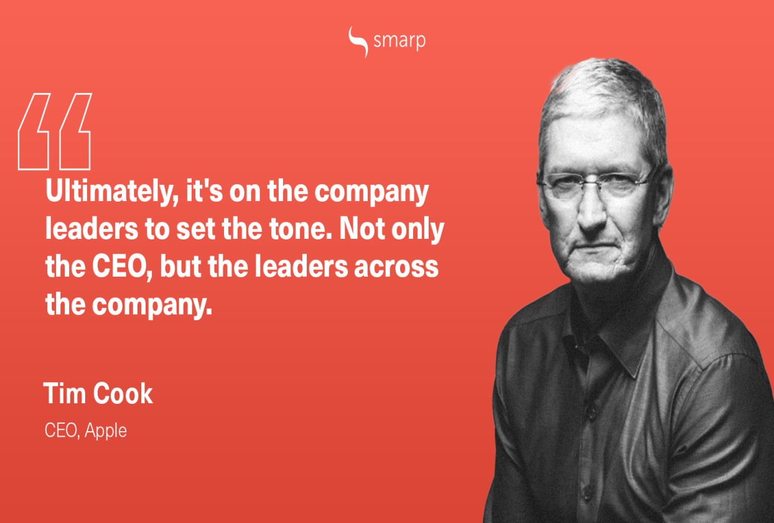
Tim Cook Strengths As A Leaders
Leading with an inspired vision
Tim took over the company with the aim of carrying on with Steve Jobs vision and legacy (Northouse, 2018).
He had a clear vision of what he wanted to transform the company to.
Notes:
All eyes were on Apple CEO Tim Cook after he took over from the iconic and masterful Steve Jobs. People did not believe he possessed the necessary leadership qualities required to help Apple continue as a tech powerhouse. We have quickly realised that this is not the case and Tim Cook is more than capable of taking Apple to the next level.

Slide 11
Tim Cook Strengths As A Leaders...
Motivating his team
Tim Cook has been motivational to the company workforce to remain focused on propelling the company to the next level.
When he became CEO, the company had just lost its founder hence it needed someone to motivate and encourage the team and that is what he has been doing since 2011 (Northouse, 2018).
Notes:
In any organization, the primary goal is to achieve success for the group. This requires collaboration, because one person simply cannot reasonably hold all the decision-making power. A transformational leader is exceptional at encouraging discussion between a group of experts in the topic or industry. They understand that the beauty is not merely in having the idea, but also in having the sense to know which ones will succeed.

Slide 12

Tim Cook Strengths As A Leaders…
Trusting his team to Deliver
Tim Cook is the kind of leader who gives every team member a chance to work and deliver on their responsibilities with no interference.
Notes:
The transformational leaders that will inspire the wave of the future in education and industry have many effective leadership skills. They know how to keep their egos in check, and the best way to take risks.
Even with the most inspirational purpose, you still need those around you to believe in it enough to find common motivation. In order to gain their trust in your ability to lead, you must appeal to the values of your team members.

Slide 13
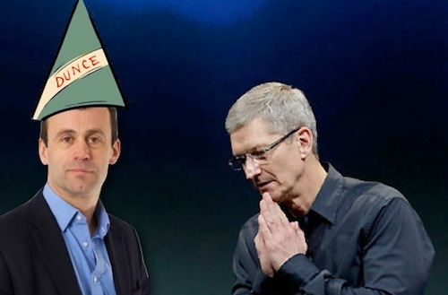
Tim Cook Weakness As A Leader
Making decisions without proper consultations
His decision of hiring John Browett as the head of stores was ill-informed and miscalculated (Heracleous & Papachroni, 2016).
John would never have adopted the company’s culture hence no value addition to the Apple.
Notes:
Just give the example of the appointment of John as head of stores and how it did not work out.

Slide 14

Tim Cook Weakness As A Leader
Loss of company Grip and Influence
A good number of employee and other opinion makers have called for resignation and retirement of Tim.
This is due to disagreement on the way the company should be led.
Notes:
Use information from the slide

Slide 15

Tim Cook Weakness As A Leader
To much freedom for the team
There is need to have a control over what employees are doing so there continuous evaluation is possible.
This is to ensure all team members remain focused on the company goals and targets.
Notes:
Being a leader is not always smooth sailing, you often have to make tough decisions. Transformational leaders do not shy away from difficult decisions like asking for

Slide 16

Recommendations
Tim Cook should involve all stakeholders when making decisions affecting the company.
Hiring of staff is a crucial task that should be done by all members including the human resource management.
This ensures that the best are hired for the great good of the company.
Notes:
Just read the slides

Slide 17
Recommendations
Cook need to assert his authority as the leader
He can do this by requesting frequent feedback and progress by the employees on the various tasks assigned.
This would ensure that the employees are conscious that they have a leader to report to as the team lead.
Monitored freedom is good for the overall progress and performance of the company.
Notes:
Read the slides
He can do this by requesting frequent feedback and progress by the employees on the various tasks assigned.

Slide 18
Personal Insight
Leadership affects the performance of a company
A leader should be conscious of their actions and be responsible
Having a transformative leader means that one is ready to be role model for the team
A role model’s actions should be aimed at propelling the company to achieving its set goals and targets.
Notes:
Having a transformative leader means that one is ready to be role model for the team

Slide 19
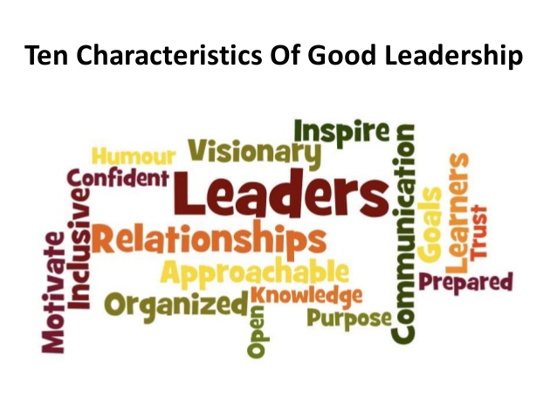
Personal Insight
Despite being accommodative leaders needs to be firm on the position and vision of the company so that even the team remains focused.
One can combine two or more leadership styles if at all they would make them better leaders.
Notes:
Despite being accommodative leaders needs to be firm on the position and vision of the company so that even the team remains focused.

Slide 20
References
Ceil, C. (2018). Importance of Leadership for Apple. Available at SSRN
3520422.
Heracleous, L., & Papachroni, A. (2016). Strategic Leadership and
Innovation at Apple Inc. SAGE Publications Ltd.
Kahney, L. (2019). Tim Cook: The Genius who Took Apple to the Next
  Level. Penguin UK.
Northouse, P. G. (2018). Leadership: Theory and practice. Sage
publications.
Perry, S. (2016). Tim Cook, a Case Study on the Effects of
Transformational Leadership on Privacy and IT Security.
Notes:
References
Thank the audience for being attentive and ask if any of them have questions regarding the presentation or even additional information.

